Slide 1
New Home&page
Lightup.co.kr
Coming1st Week of April

Slide 2
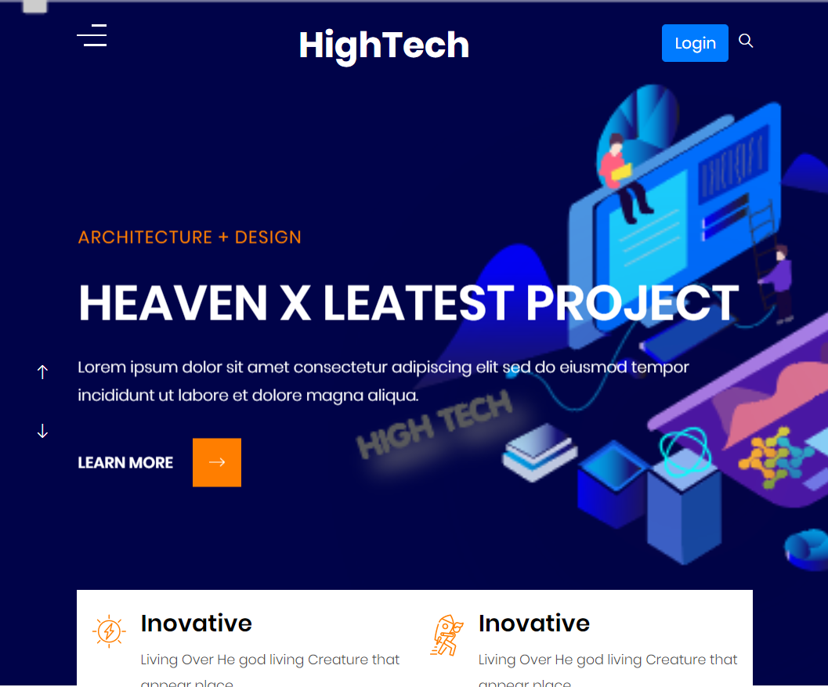
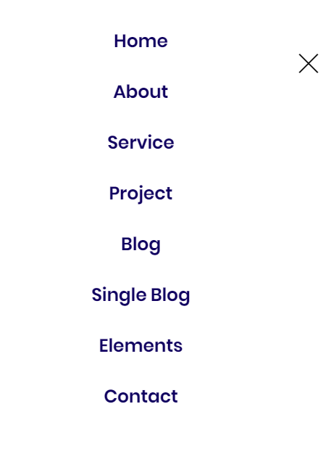
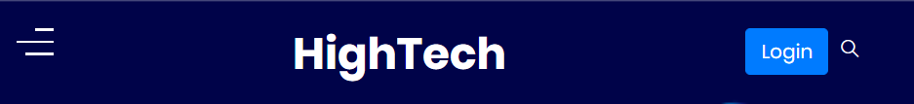

Landing page
Top/side menu bar & animation
Transition effects
From hamburger button to flyout menu, animation is done like datum360.com.

Slide 3
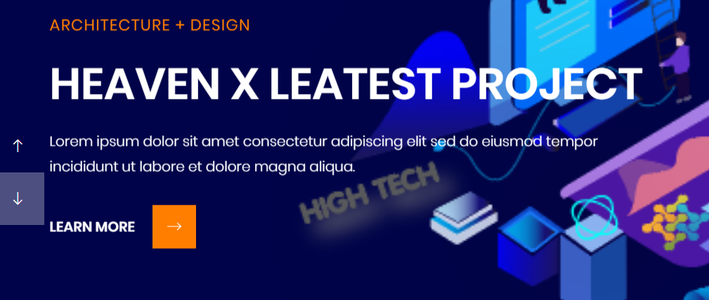
Banner Box
5 slides
Slide 1 → Deep Learning
Slide 2 → Sensors
Slide 3 → IoT Monitoring App
Slide 4 → Termite Detection
Slide 5 → Solution
Animation

Slide 4
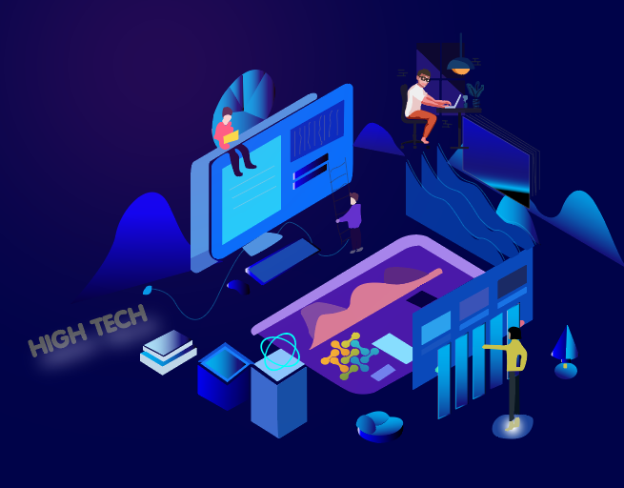


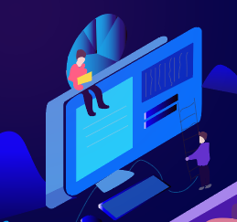
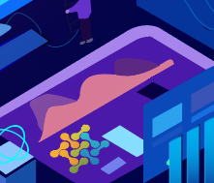
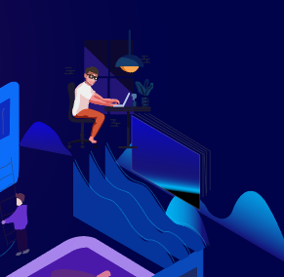
Slide transition
Panning and camera move work of each elements like a parallax effects on the slide elements.
From a far background is the pitch blue) then start zooming in like from a view in dead-dropping airplane cockpit and swoops around the elements in parallax until zooms in on the logo screen and transition effects before the next slide appears afar.
While animation is played out, some of contents such as texts or images are displayed on a side box
Next Slide

Slide 5

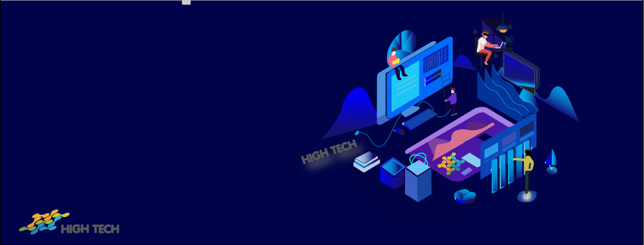
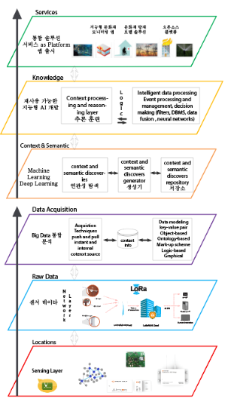
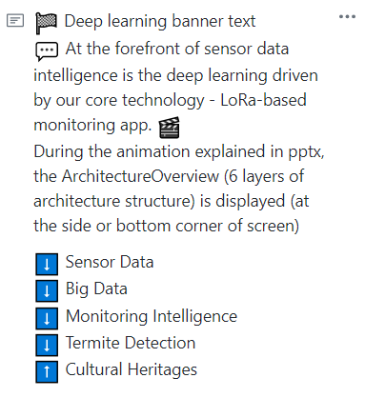
#1 Deep Learning
This and the right image in svg should be animated. The slide logo also is animated based on the design.
At the forefront of sensor data intelligence is the deep learning driven by our core technology – LoRa-based monitoring app.
Context and semantic learning
- context and semantic discoveries are used to create its generator and consequential discovers repositories.
Context and reasoning layer is added for intelligent data processing, event processing and management and decision making (filters, DBMS, data fusion, neural networks)
Pattern and trend algorithms
- noise and pattern identification
- max / average pooling
1. Based on the calculation of energy level derived from the frequency size of accelerometers and vibration sensors, so-called "Cultural Health Index" is to be developed to determine the health and out of balance of cultural properties being monitored. And at the same token, a "Danger Index" is to be developed by identifying the impact level of the result.
Big Data
Analysis and data acquisition techniques using push and pull instant and internal context source.
Data modeling with key-value pair, object-based, ontology-based, markup scheme, logic-based and graphical context info.
> Inter-relational analysis
- relational analysis based on sensor proximity
- Weather API parsing and data matching engine development
- Data assimilation
- Total integration of data

Slide 6
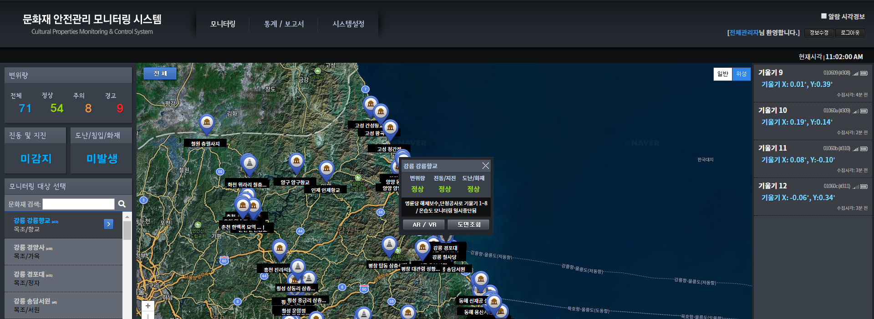
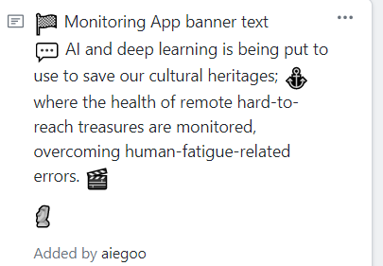
IoT Monitoring App
This would require a complete fake app design required.
usn.lightup.co.kr/olorasys/cultasset
AI and deep learning is being put to use to save our cultural heritages; where the health of remote hard-to-reach treasures are monitored, overcoming human-fatigue-related errors
Cultural Asset Monitoring App
LoRa r technology protocol enables 15km as maximum data transmit distance.
Low power consumption guarantees longer lasting of batteries.
Self-managed network costs you nothing in usage charges.
Use of batteries reduces overheads in wiring for power connection.

Slide 7
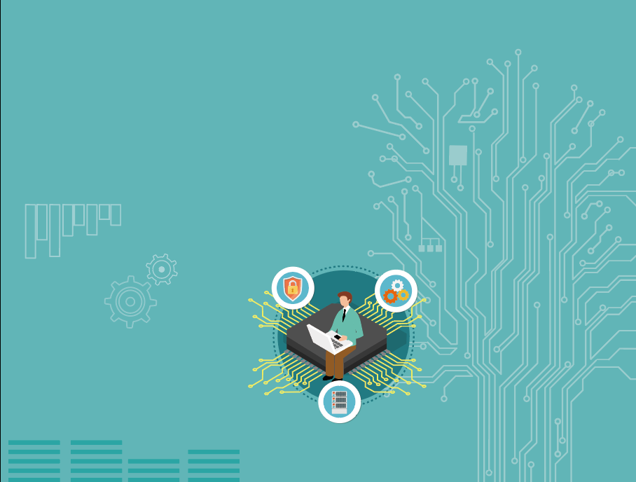
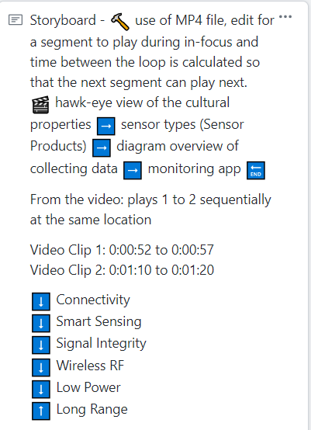
Sensors
Combining discrepancy sensors and LoRa-based transceiver, High Tech sensors are the preferred choice for low-power hard-to-reach locations, well-kept hidden from the public view, ideal for public malls and cultural heritage sites.
LoRa-based devices come with various advantages including the following;
- Extremely low power consumption performance, which means battery-equipped end-points last longer and can be placed in hard-to-reach locations.
- LoRa opensource ecosystem guarantees a broad ecosystem of devices, gateways, applications and portals for developers.

Slide 8
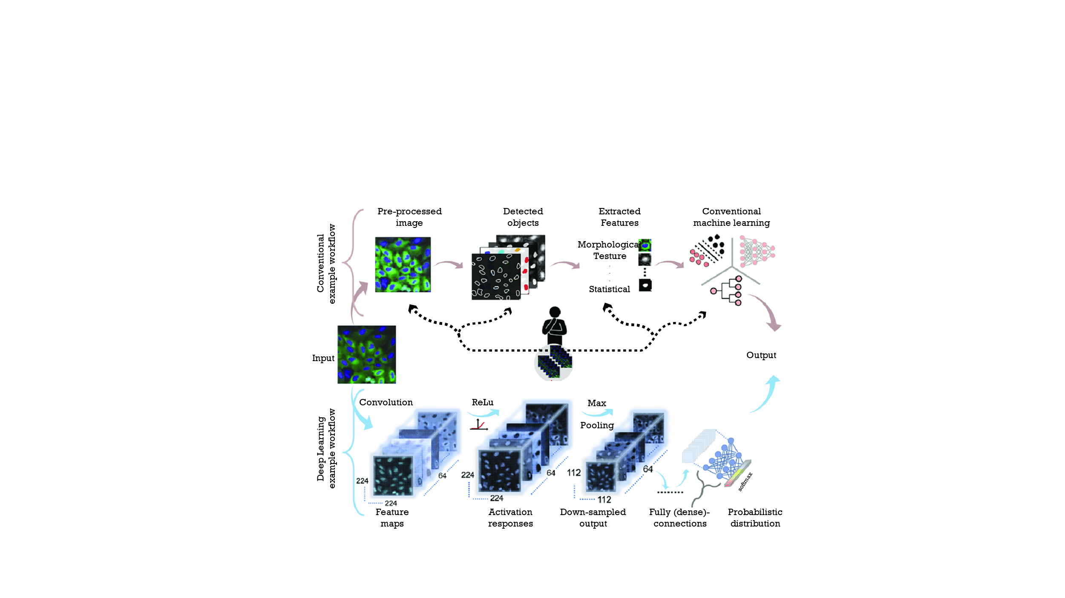
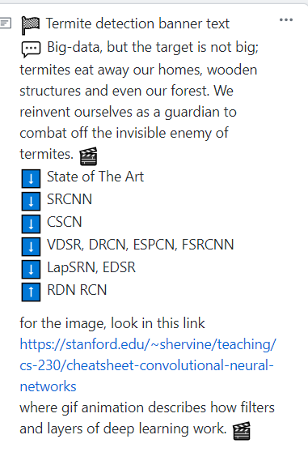
Termite Detection
Animation of process.
Actual file name is OverviewDeep-learning.png
Big-data, but the target is not big; termites eat away our homes, wooden structures and even our forest. We reinvent ourselves as a guardian to combat off the invisible enemy of the termites
Termites are the main causes of damages done to wooden structure and forest trees. Because of its aggressiveness and hidden existence, it is extremely hard to detect and evaluate its existence and damages.
Our temperature and humidity sensors coupled with the imaging devices can tackle this issue and we can deliver a self-contained solution based on deep-learning platform, which can produce alarms with visual results.

Slide 9
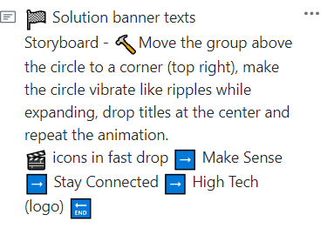
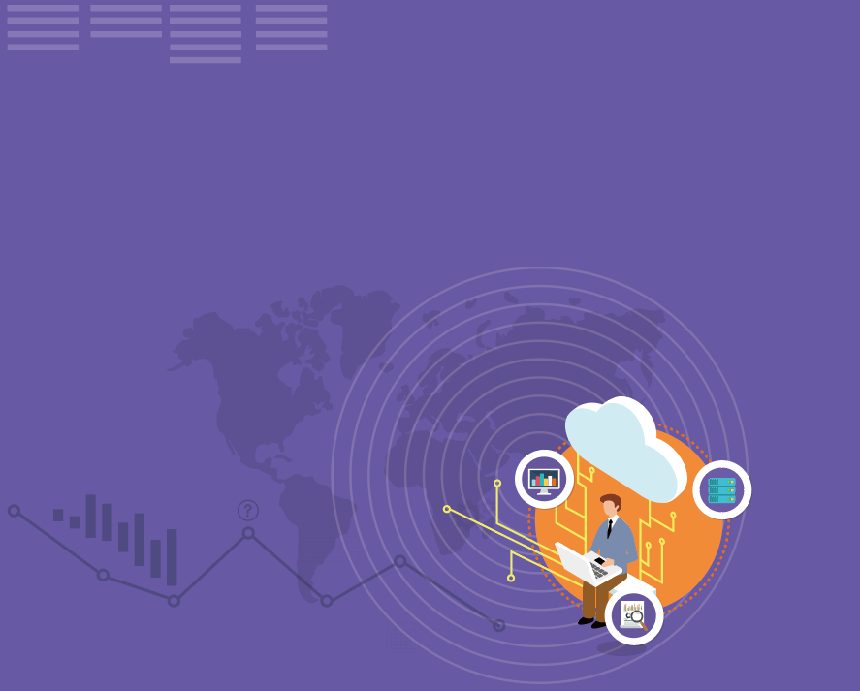
Solution
:checkered_flag: Solution banner texts
:speech_balloon:
At High Tech, we create more than just monitoring app or deep learning scientific platforms. We bring it to life with user experience, translating data values into real, tangible and graphical visualization.
We provide you in a wide range of sectors with a professional, yet refreshingly personal approach.
Join us, and thrive on your ventures
HIGH TECH is a company dedicated to Internet of things (IoT).
We provide services based on LoRa, BLE, and IoT sensors, and our products include O-lamps as well as Home wireless local network products and services.
We've been expanding heavily by investing in our development to reinvent ourselves as the beacon of innovation and invention.
We launched outdoor lamps, a product named ‘O-lamp’ in 2016. The lamp has been popular among outdoor-loving fans.
On top of the popularity, we finally found our niche market in the area of cultural heritage preservation by launching our proud flagship of Monitoring System first in our province and by expanding its market across the country.
With all the discipline under one roof, we are prepared to meet the challenges of IoT devices from concept, through certification and into mass production and installation.
If your imagination for the future of IoT technology is the same as of us, please join us and we can go far together.

Slide 10
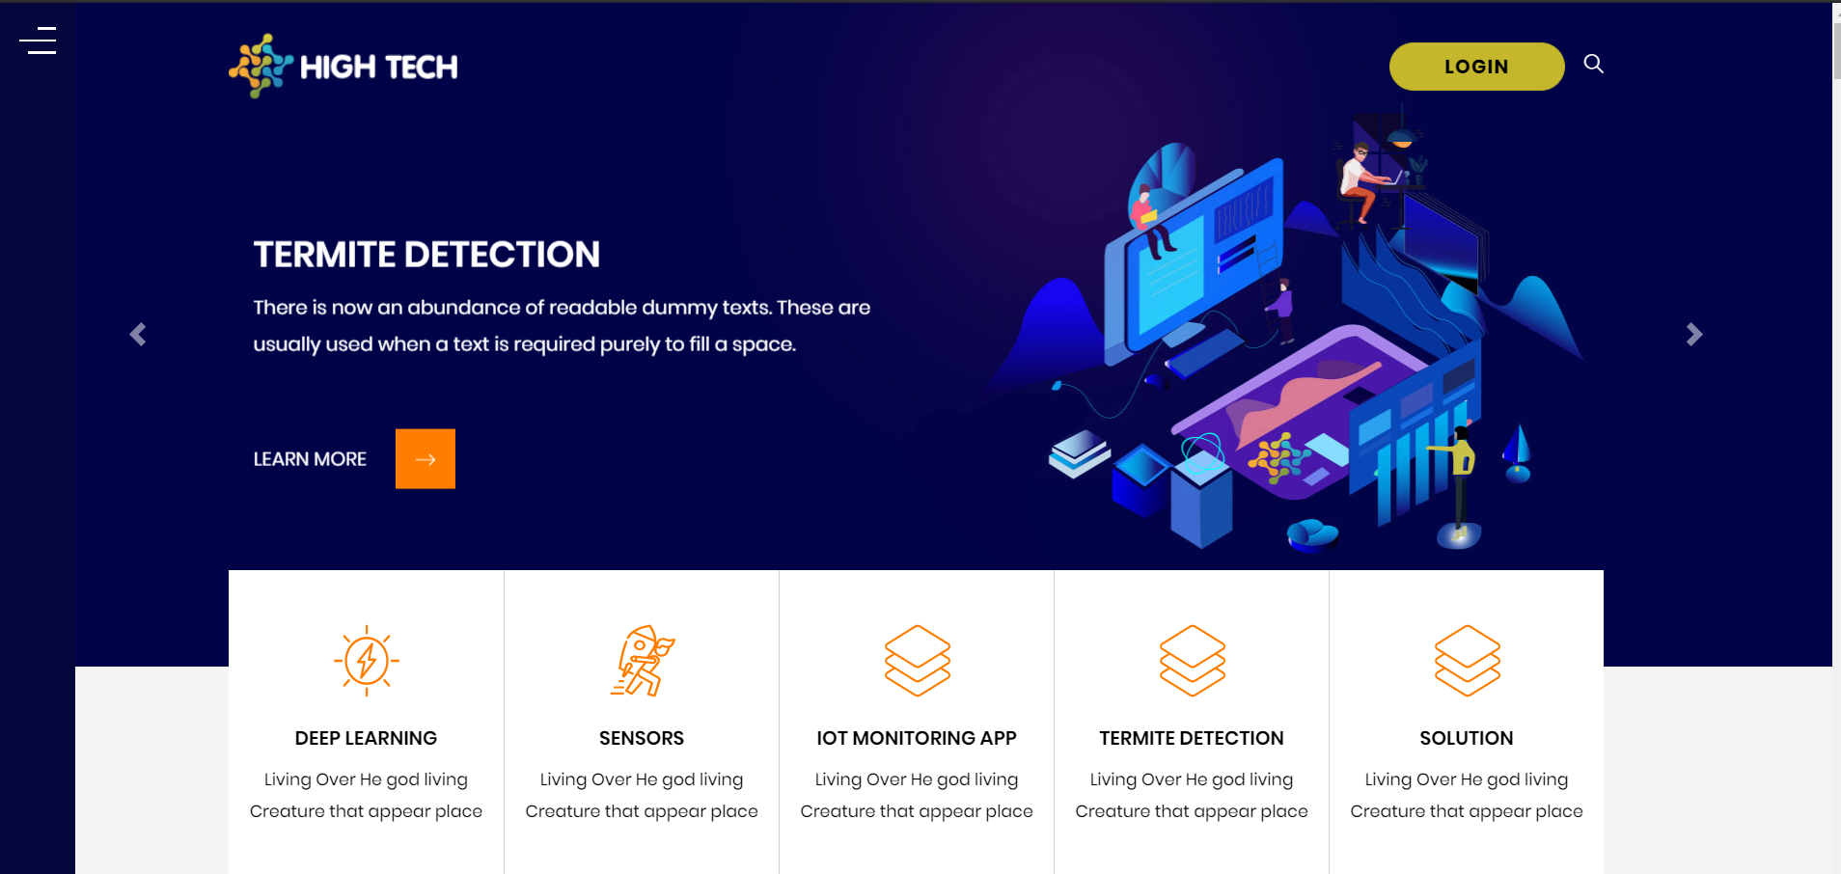
Logo
solid color
Button
Menu
Hero slider
Need to add just
images for the 5 slider
Icons/texts – this is the
Pagination of the slides
Like in olora-web
Sensor data / Data analysis
LoRaWAN /
Low power long range
Live data update / dashboard
Image analysis /
AIoT solution
Let sense prevail / stay connected
For active slide, the orange bar at the bottom is not visible. Make the icon bigger too as well
for mobile size, this hero sectiosolid color
n and footer will be displayed only. Instead, we add a link of “For a pc version, click here”

Slide 11

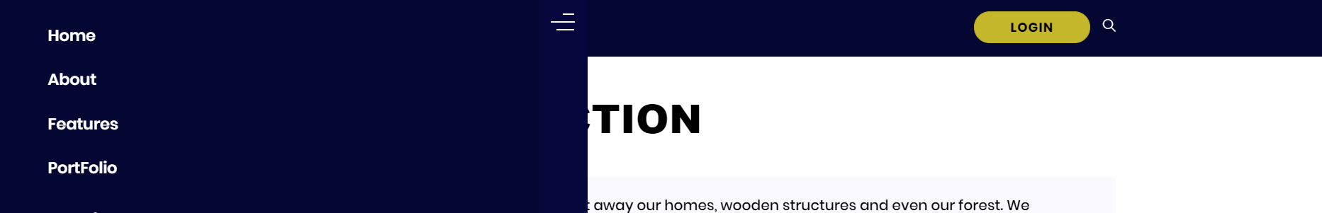
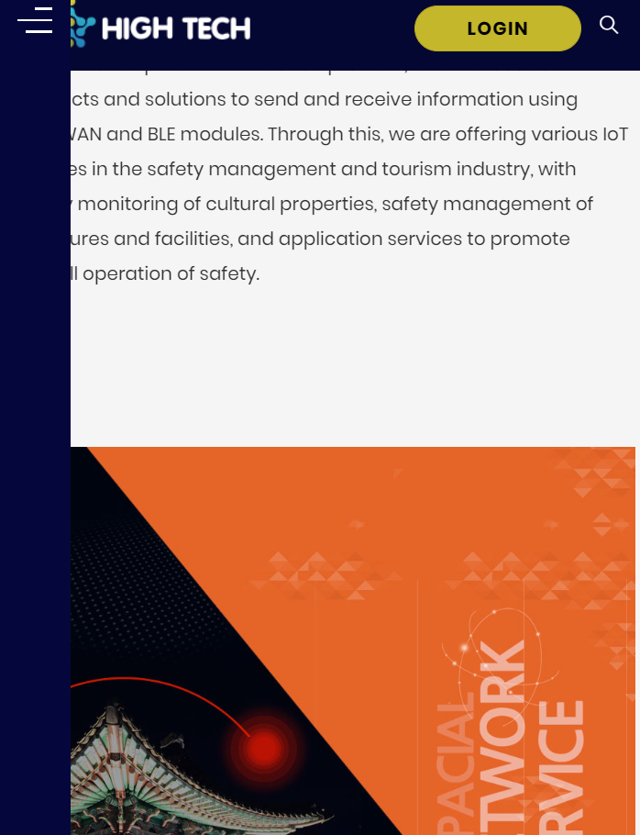
Search bar
Hamburger Menu
Long lines as in datum360.com
It needs to be hamburger visible
not the bar itself when not selected
Sticky menu

Slide 12
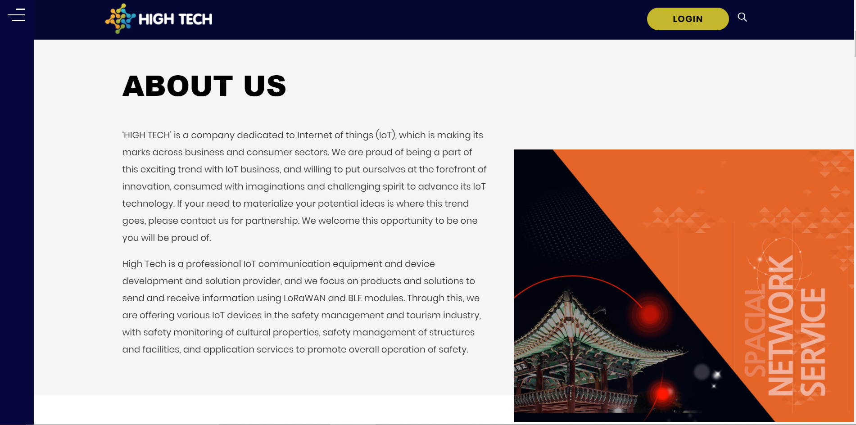
In small screen, make the text box appear only

Slide 13
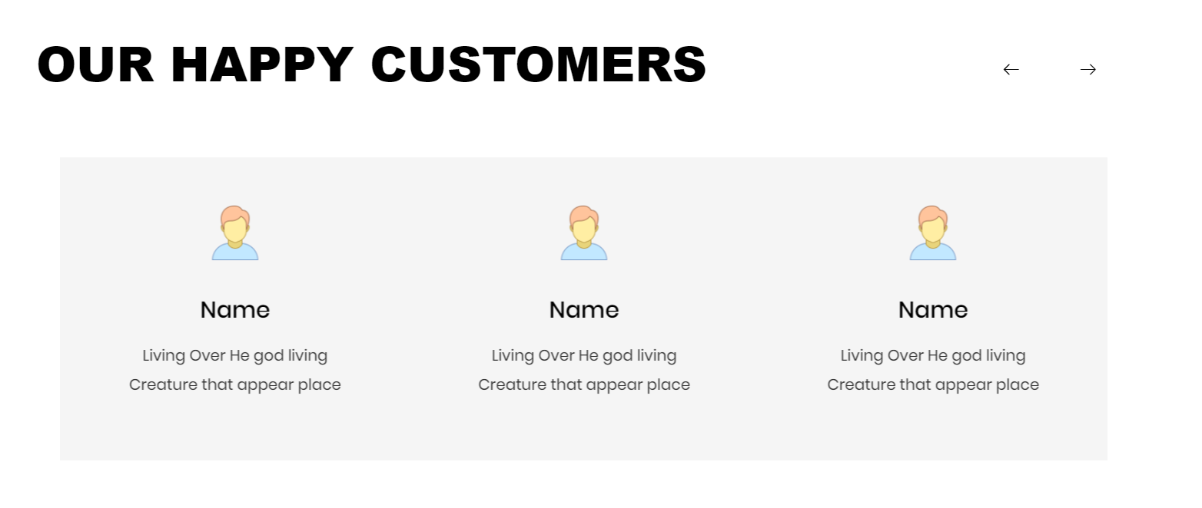









 | Logo | Name | Sub-title | Link to logo
GANGWON |  | Gangwon Province | IoT Monitoring App | https://www.provin.gangwon.kr/gw/portal/sub03_02_03
GANGWON Culture Institute |  |  | IoT Monitoring App
SK Telecom |  |  | Alliance
SENKO |  |  | Partner | http://www.senko.co.kr/web2019/images/common/logo_w.png
Seoul Metro |  |  | IoT Monitoring App | http://www.seoulmetro.co.kr/kr/page.do?menuIdx=507
Sacheon City |  | Sacheon Mecca of high-tech aviation industry |  | https://www.sacheon.go.kr/english/02545/02550.web
Gangneung City |  | Gangneung City |  | https://www.gn.go.kr/www/contents.do?key=721
Wonju City |  | Wonju city |  | http://www.wonju.go.kr/www/contents.do?key=235
Hongcheongun |  | Hongcheon |  | https://www.hongcheon.go.kr/www/contents.do?key=305
강원도청
강원문화재연구소
SK텔레콤
센코
도시철도공사
사천군
원주시
강릉시
홍천군

Slide 14
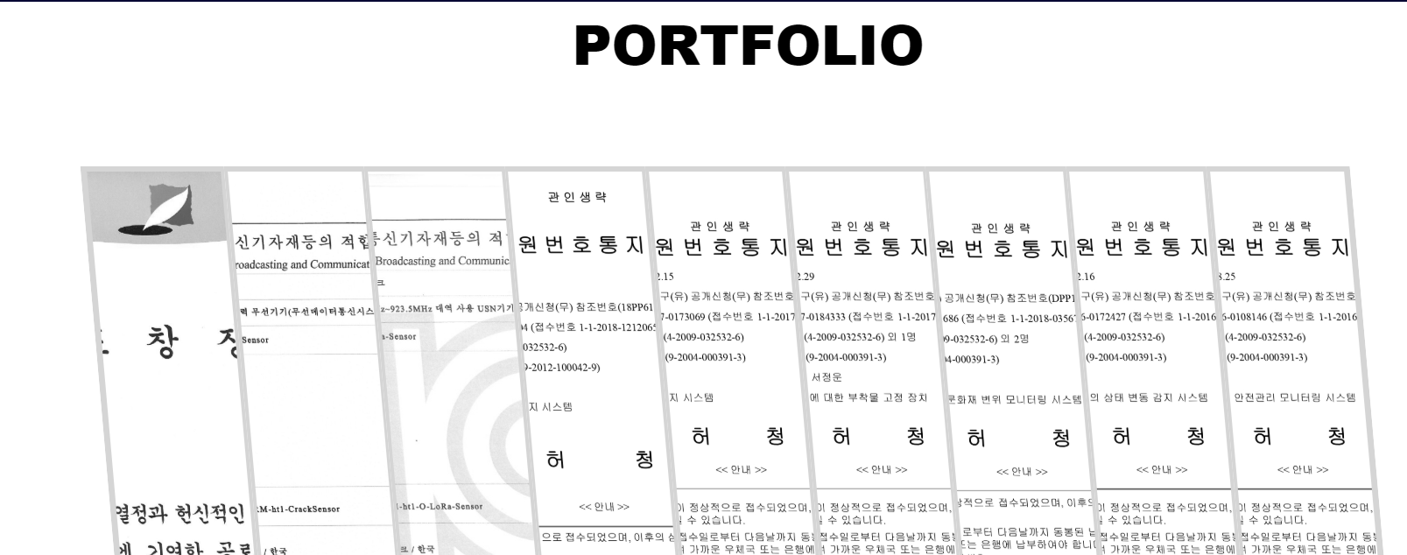
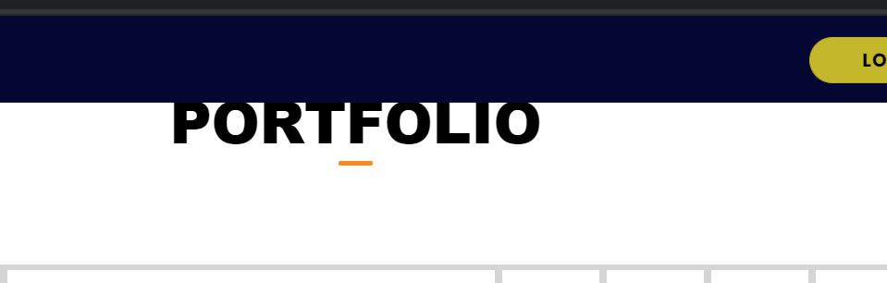
PORTFOLIO needs to move down (top margin 50pt) to be centered in the space
This has to be implemented, the collapsed bar should be solid color, not transparent, only the those in display need to be transparent.
Award
Certificates
Patent 1
Patent 2
Patent 3
Patents
the bar takes up the full width

Slide 15
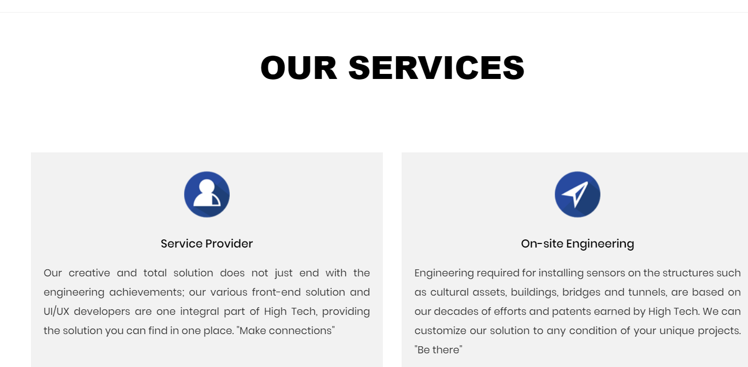
Design block and set alignment of text
Icons are too plain.. Think of something else.

Slide 16
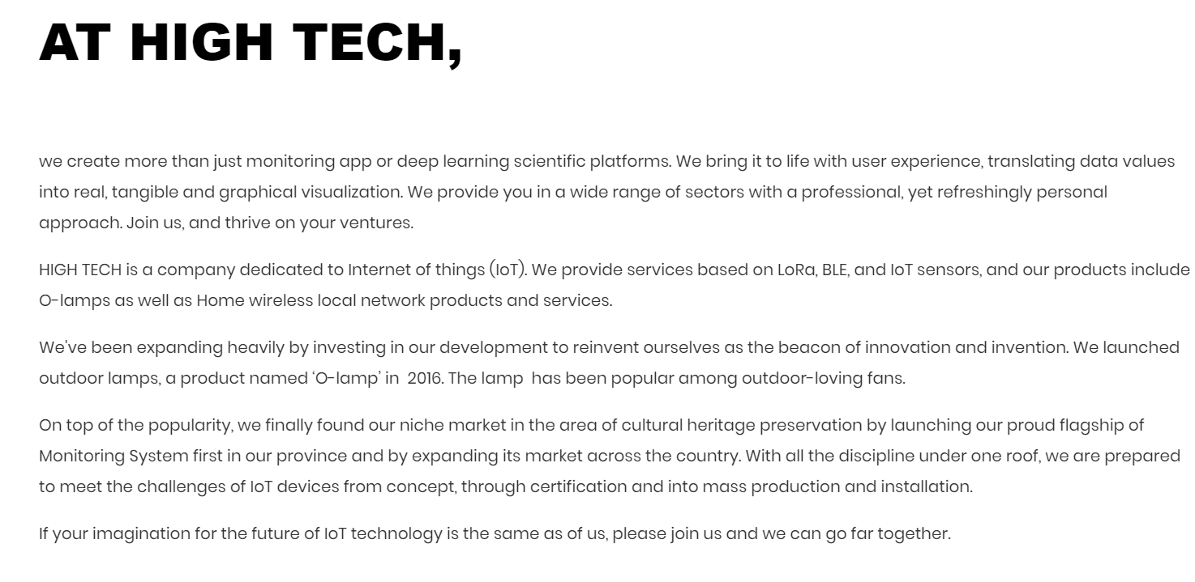
Set alignment of text

Slide 17
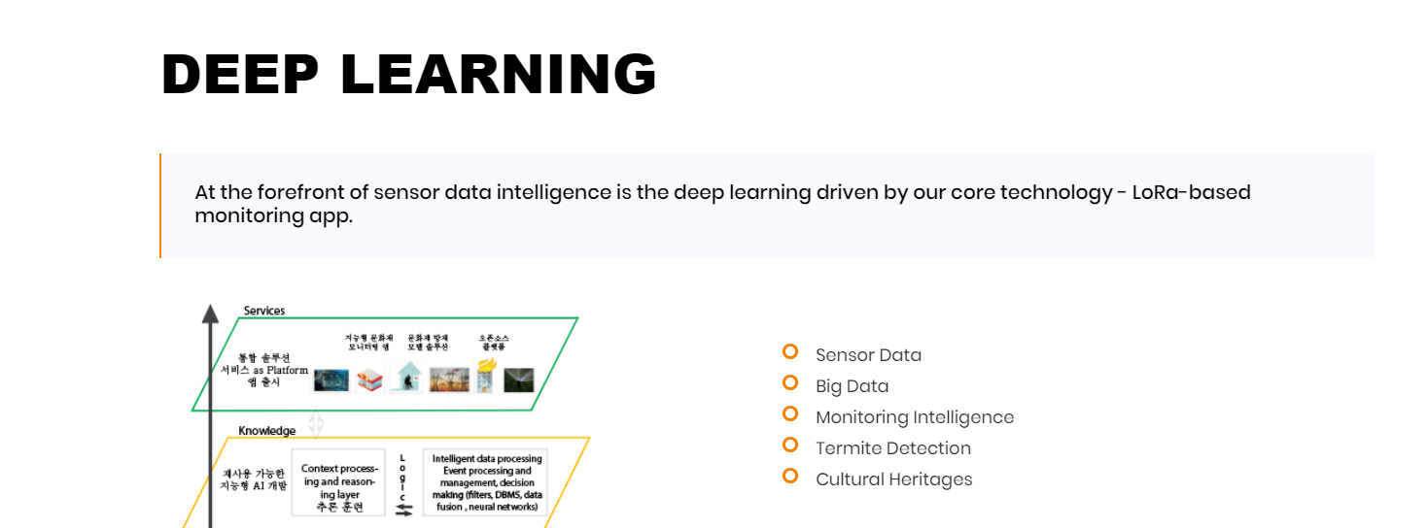
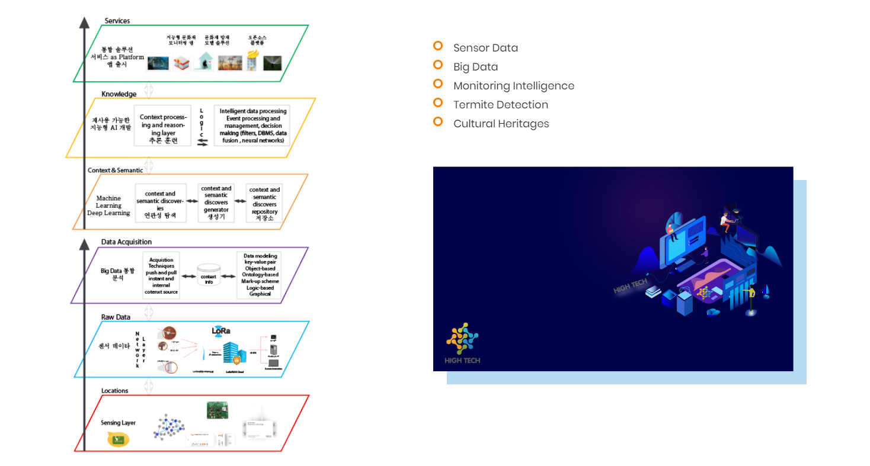
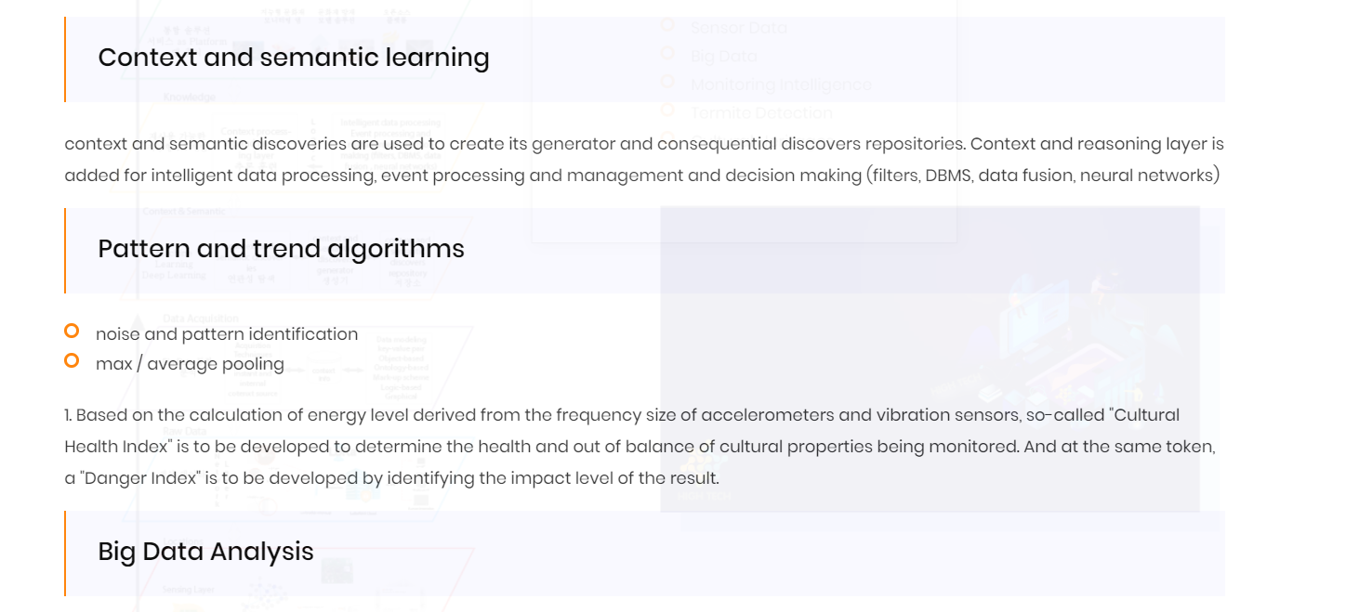
I provide you with reference pptx file, how this architecture diagram should be rendered
Added image also design that block and Set alignment of text

Slide 18
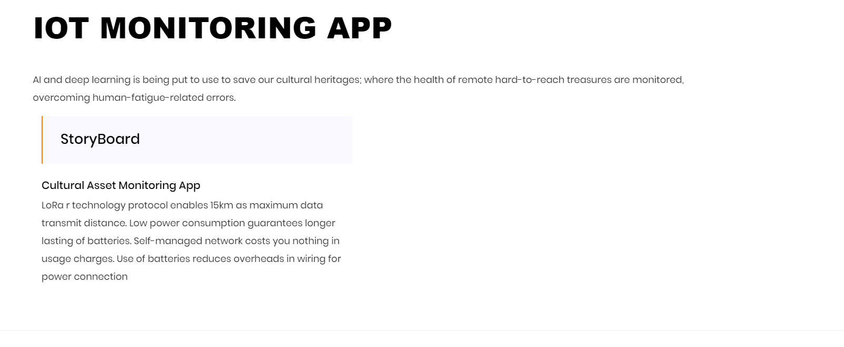
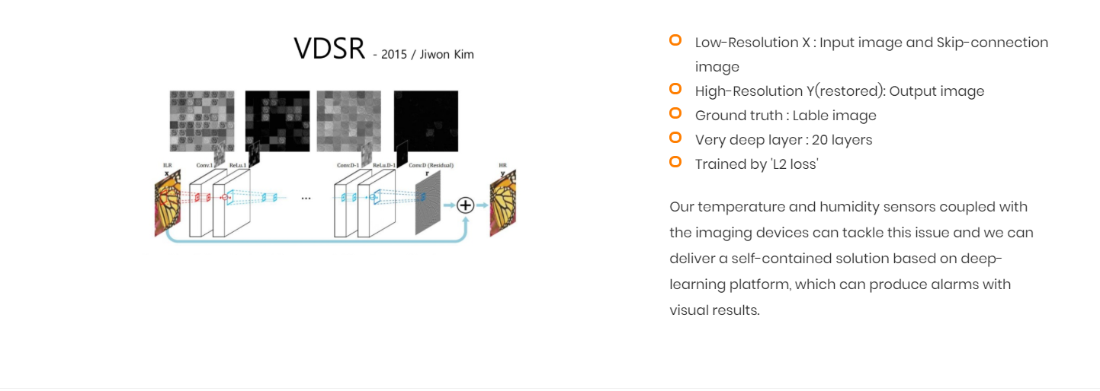
remove
Add here fake app that
Now I put as empty
Please create one from the screen shot
Image resize, design that block and Set alignment of text

Slide 19
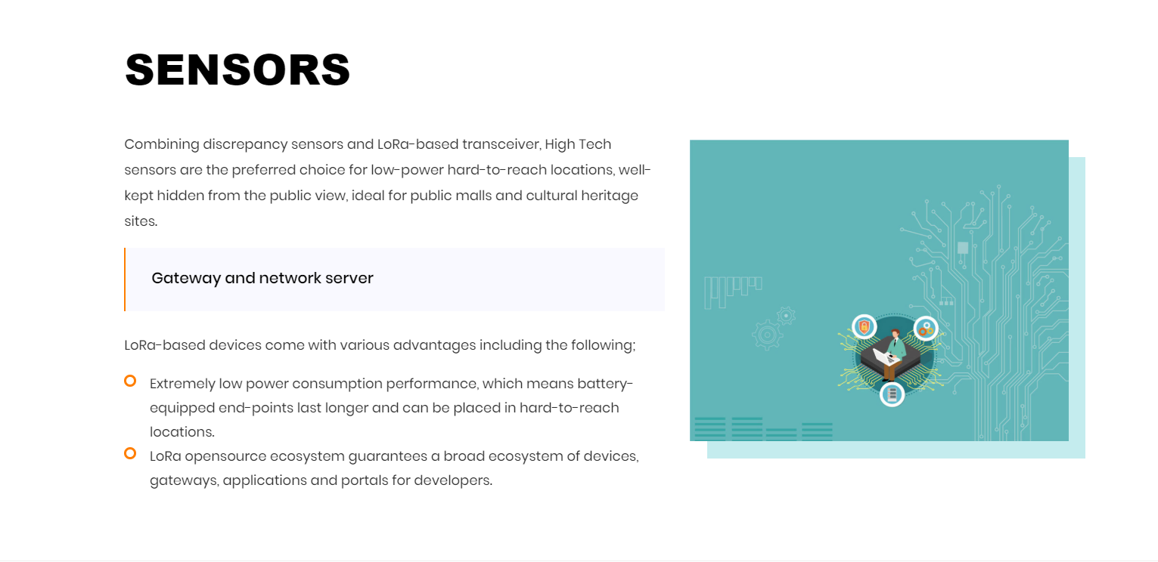
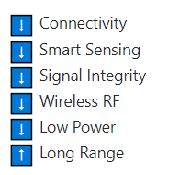
Added image also design that block and Set alignment of text

Slide 20
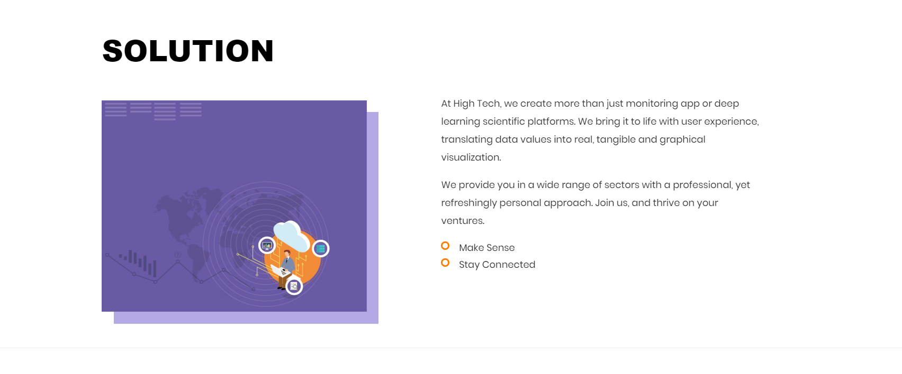
Added image also design that block and Set alignment of text

Slide 21
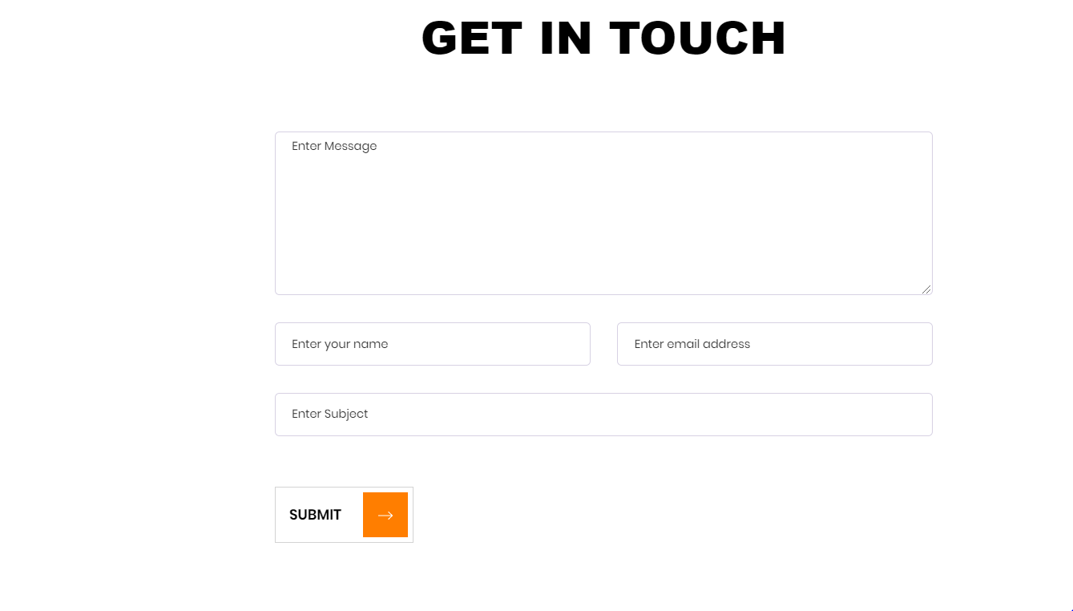
I will provide necessary information for the mail backend.
What do you need?

Slide 22
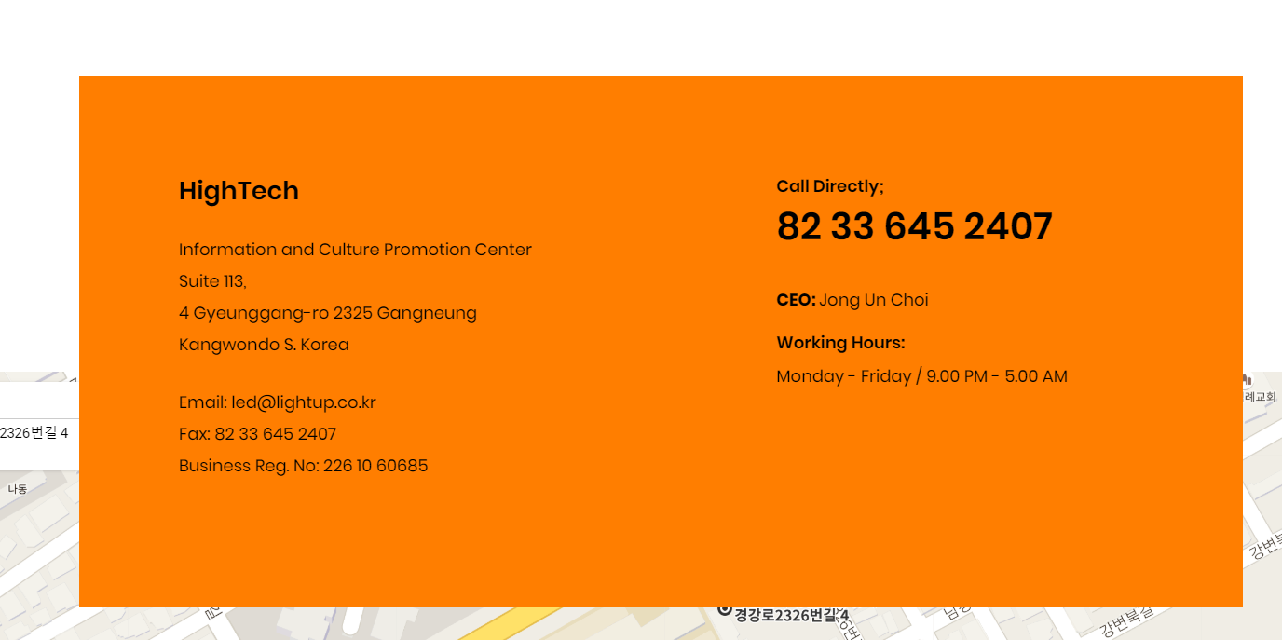
Added content like address, email etc.

Slide 23
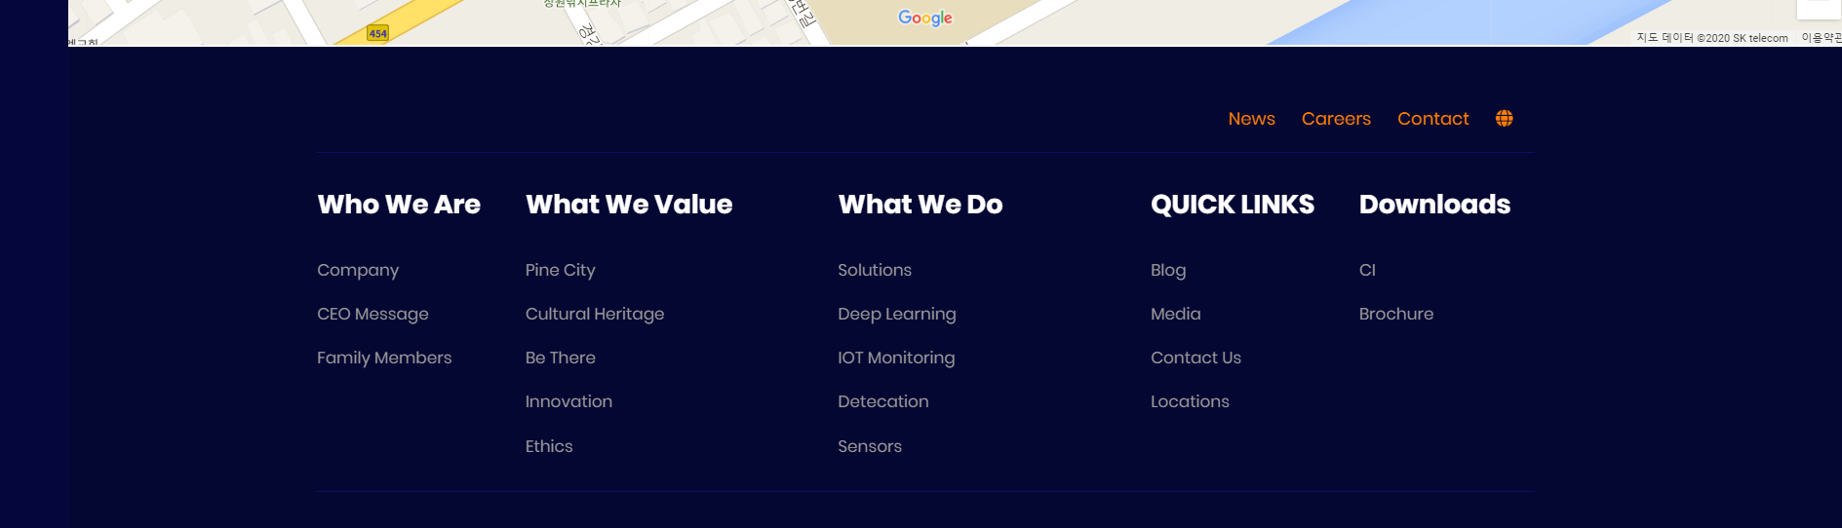
The copyright 2019 should be 2020
Thank you!!

